Slide 1
Health App Menu Structure

Slide 2
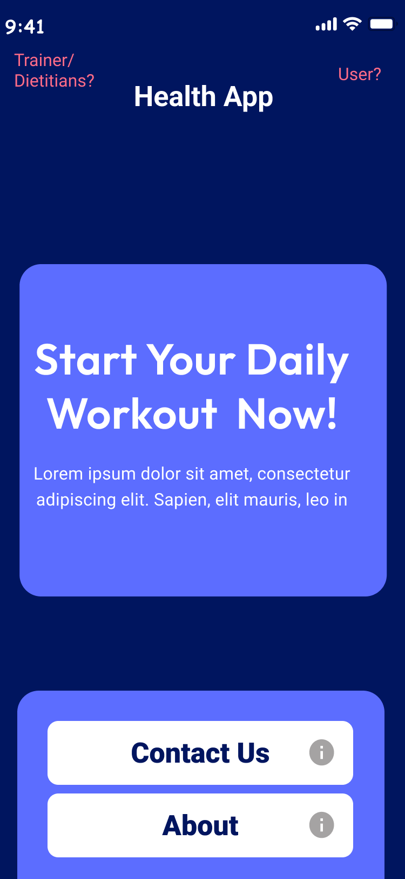
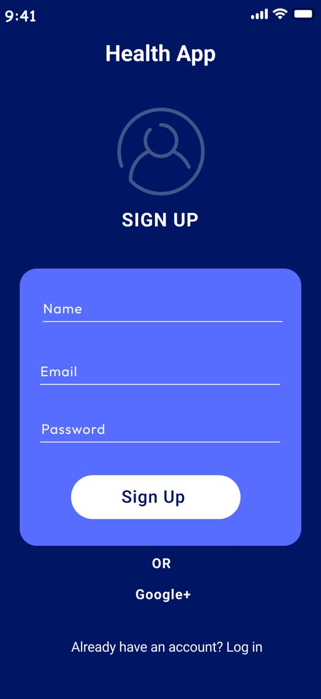
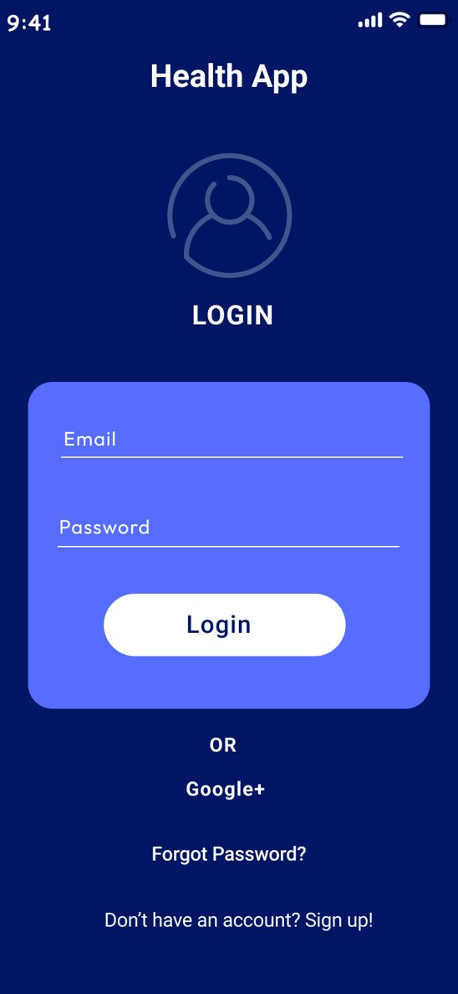
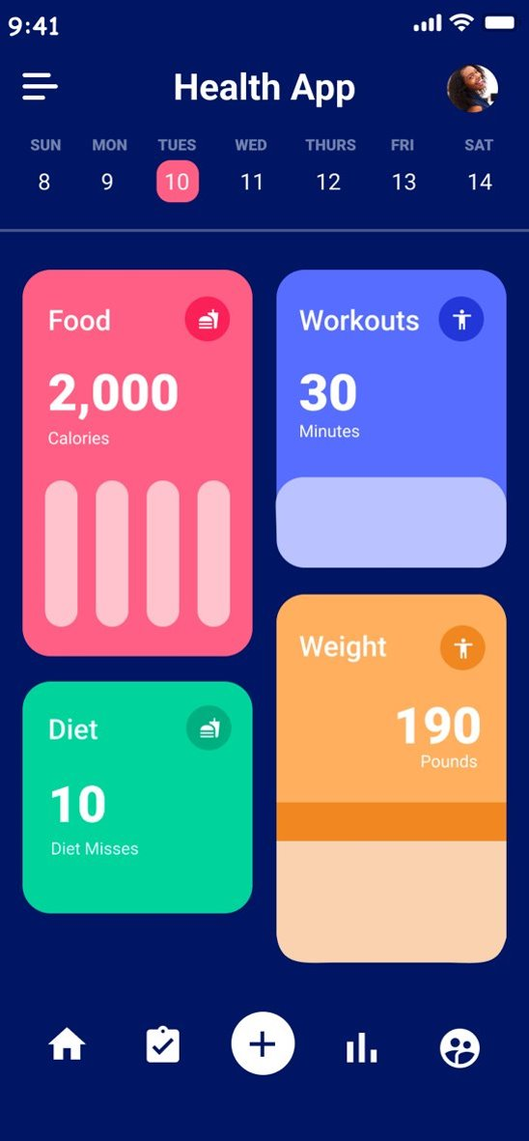

Slide 3
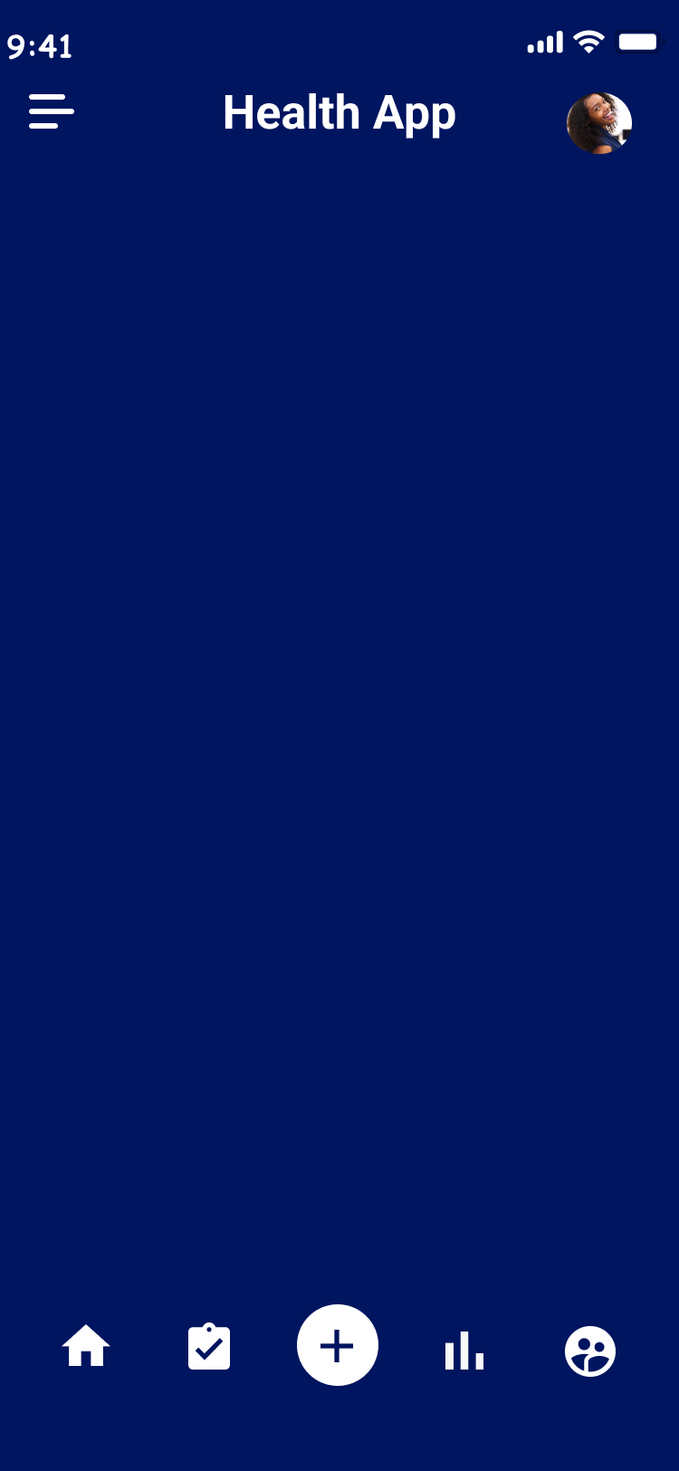





Bottom Tabs Navigation
Home
Redirect the user to the home screen, where users can see their summary related of their diet or workout.
Tasks
Shows the list of tasks of the users. Users cand add/mark as completed the food or exercises pending of that day.
Add
Shows a pop up where users can add the exercise or calories to track.
Statistics
Shows all information of the user in a period and get their activity.
Trainers / Dietitians
Shows the lists of professionals registered in the app and they can choose their coach accordingly.

Slide 4
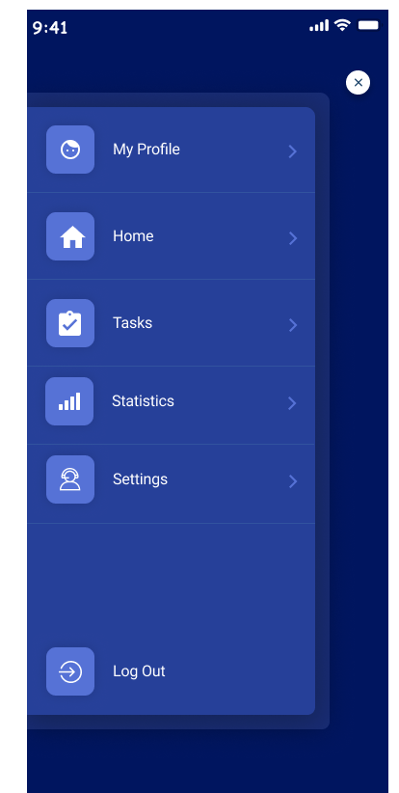
Hamburger menu
My Profile
Leads to a screen which shows user profile details. Such as name, location, etc. From there user can activate edit mode and change information if needed.
Home
Redirect the user to the home screen, where users can see the summary related of their diet or workout.
Tasks
Shows the list of tasks of the users. Users can add/mark as completed the food or exercises pending of that day.
Statistics
Shows all information of the user in a period and get their activity.
Settings
Settings related application.
Log out
Allows user to sign out of the application

Slide 5
More Information
Implementation
The images of the menus in the presentation are screen shots of the application at the current stage of the development build.
Styling
The color scheme, font and overall style do not reflect there look of the finished product. They only serve as a simple placeholder to allows demonstration of the menu structure. As production goes on styling will be implemented. However, the position and functionality of the navigation is not expected to change.
Code base
Implemented with React-Native in the front end and in the backend is Golang. Code is accessible through the teams GitHub project repo.

